Slide 1

Economic & Demographic Trends Analysis
K.Srinishaanthi
Da|ds intern trainee

Slide 2
Project Objective
Analyze Global economic and demographic trends across various parameters
Make interactive dashboard
Report key insights and recommendations

Slide 3
Data set Overview
Countries world
Population
(1960-2016)
GDP
(1960-2016)

Slide 4
Data Cleaning
Power query
Handled missing values
Removed Duplicates
Standardized Data types
Transformed & Data modelled

Slide 5
Statistical Analysis
Infant Mortality Rate
Population
Gross Domestic Product(GDP)
Literacy rate
Growth trends

Slide 6
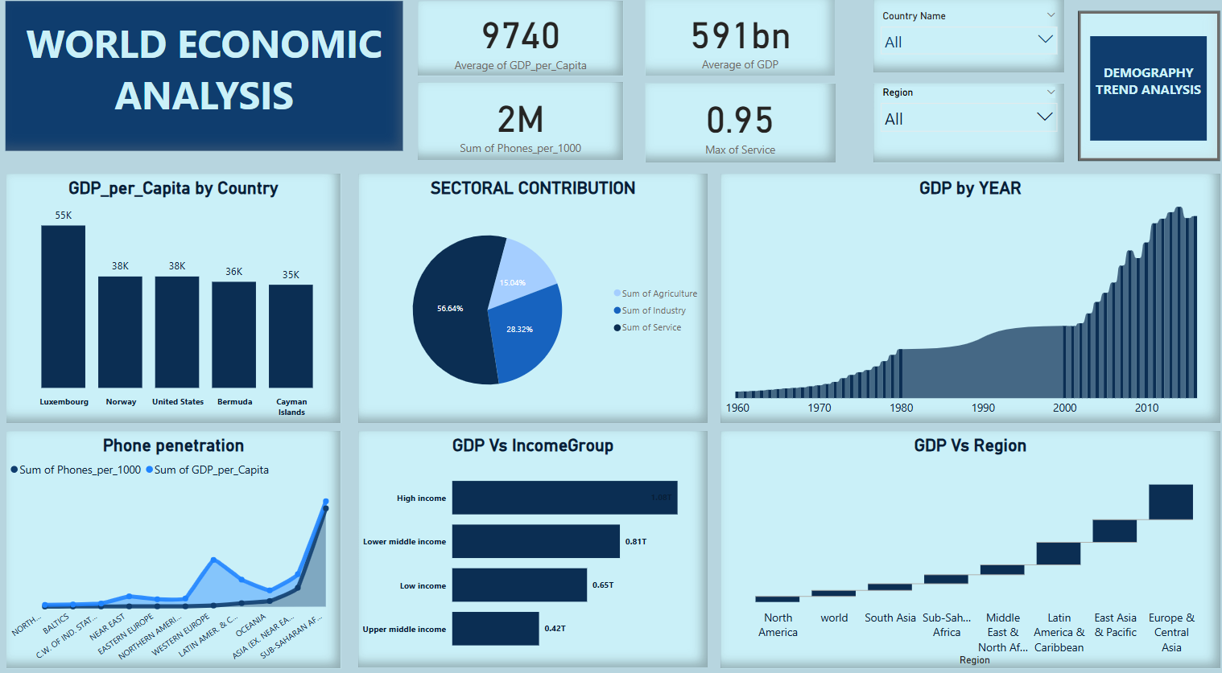

Slide 7
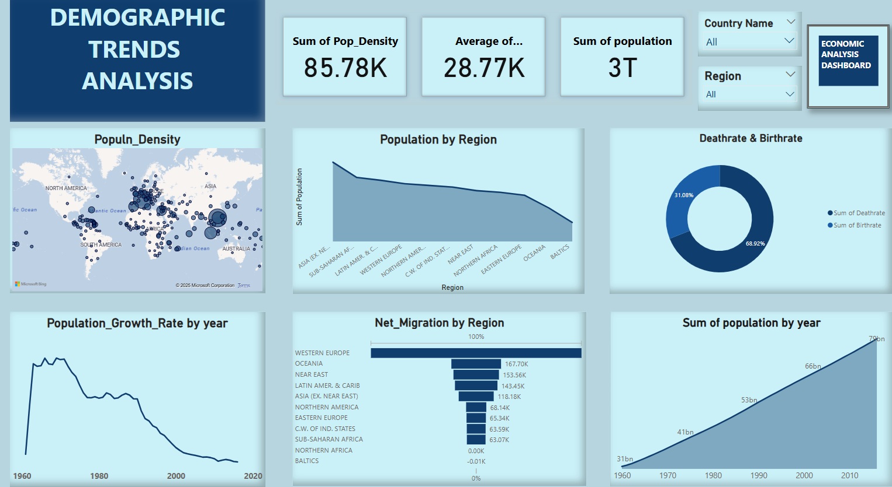

Slide 8
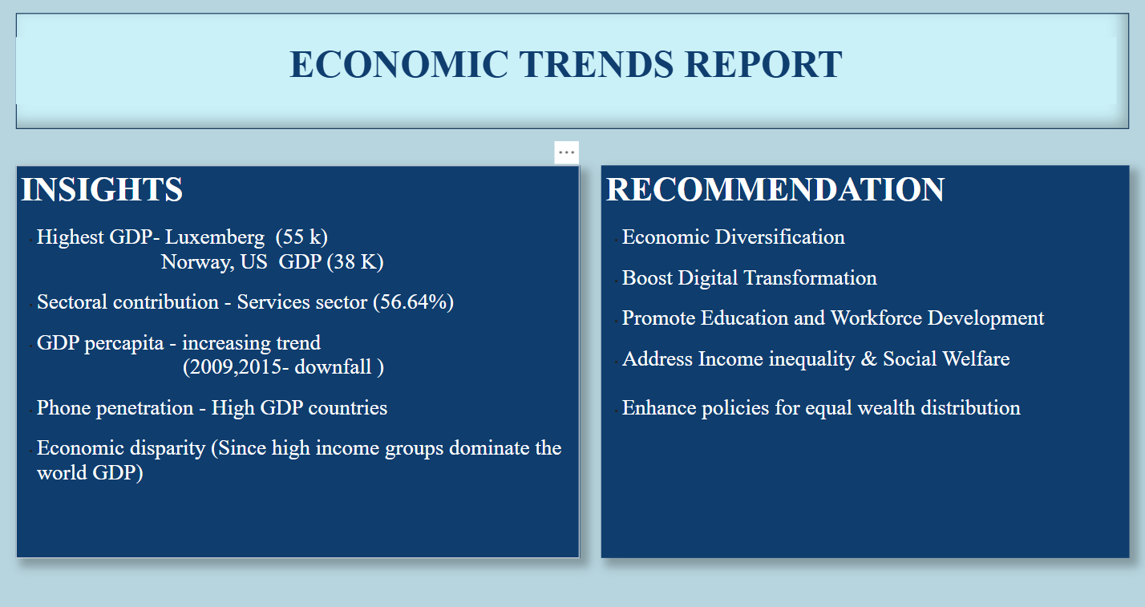
Economic Trends Report

Slide 9
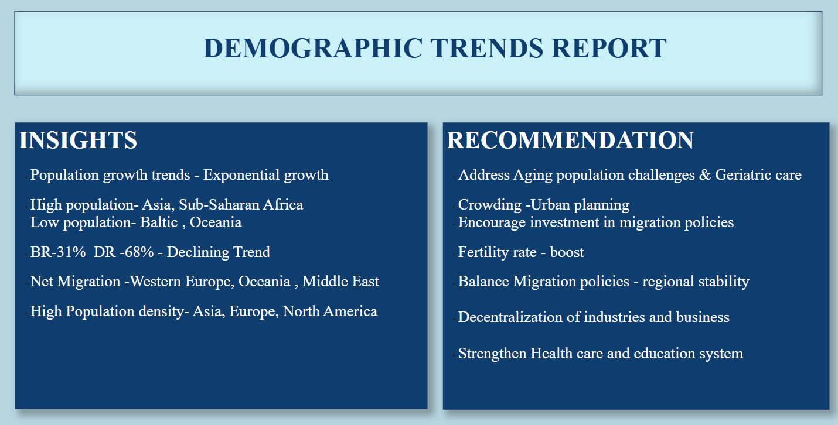
Demographic Trends Report

Slide 10
Thank You

